Slide 1
Foundation of computer science
By : Mohamed Agami

Slide 2

Lecturer 16

Slide 3

Disk Optimization

Slide 4

Optimizing Disks
Clean up the Hard Drive
1
Defrag the Hard Drive
2
Check the Hard Drive for Errors
3

Slide 5
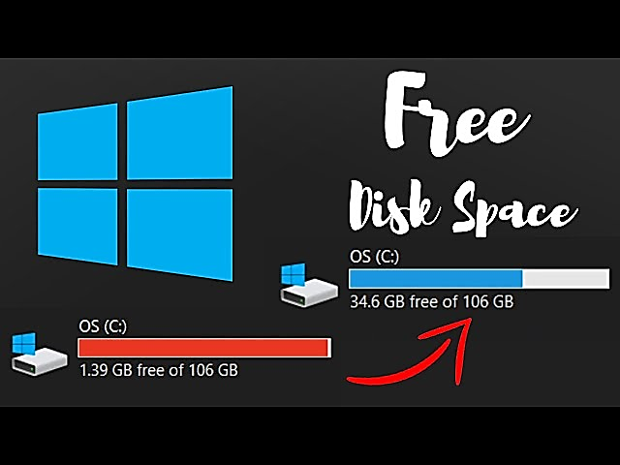
Clean up the Hard Drive

Slide 6

Directory Structures
Local disk (C)
Program files
Windows data
User data

Slide 7

User Profile Namespace
A user folder together with its subfolders.
NTUSER.DAT

Slide 8

Program Files
Program files are stored in C:\Program Files for 32-bit versions of Windows.
Program files are stored in C:\Program Files and C:\Program Files(x86) for 64-bit versions of Windows.

Slide 9

Folders for Windows Data
Registry
Initialization Files
.ini |.inf

Slide 10





Folders for Windows Data
Registry location.
The Windows registry is stored in the C:\Windows\System32\config folder.
Backup of the registry.
A backup of the registry is stored in the C:\Windows\System32\config\RegBack folder.
Fonts.
Fonts are stored in the C:\Windows\Fonts folder.
Temporary files.
These files, which are used by Windows when it is installing software and performing other maintenance tasks, are stored in the C:\Windows\Temp folder.
Offline files.
C:\Windows\CSC

Slide 11

Defrag the Hard Drive

Slide 12



Check the Hard Drive for Errors
- Lost Clusters
- Cross-Linked Files
- Bad Sectors

Slide 13
Installing Windows 10

Slide 14
Installing windows 10
Planning for Installation
Installation
After installation

Slide 15
Planning for Installation
1
2
3
4
Determine Hardware Requirements And Compatibility
Choose Between An Upgrade And A Clean Installation
Determine Appropriate Editions By Device Type
Determine And Create Appropriate Installation Media

Slide 16





Determine Hardware Requirements And Compatibility
Processor: 1 gigahertz (GHz) or faster processor or SoC
RAM: 1 gigabyte (GB) for 32-bit or 2 GB for 64-bit
Hard disk space: 16 GB for 32-bit OS or 20 GB for 64-bit OS
Graphics card: DirectX 9 or later with WDDM 1.0 driver
Display: 800 x 600

Slide 17


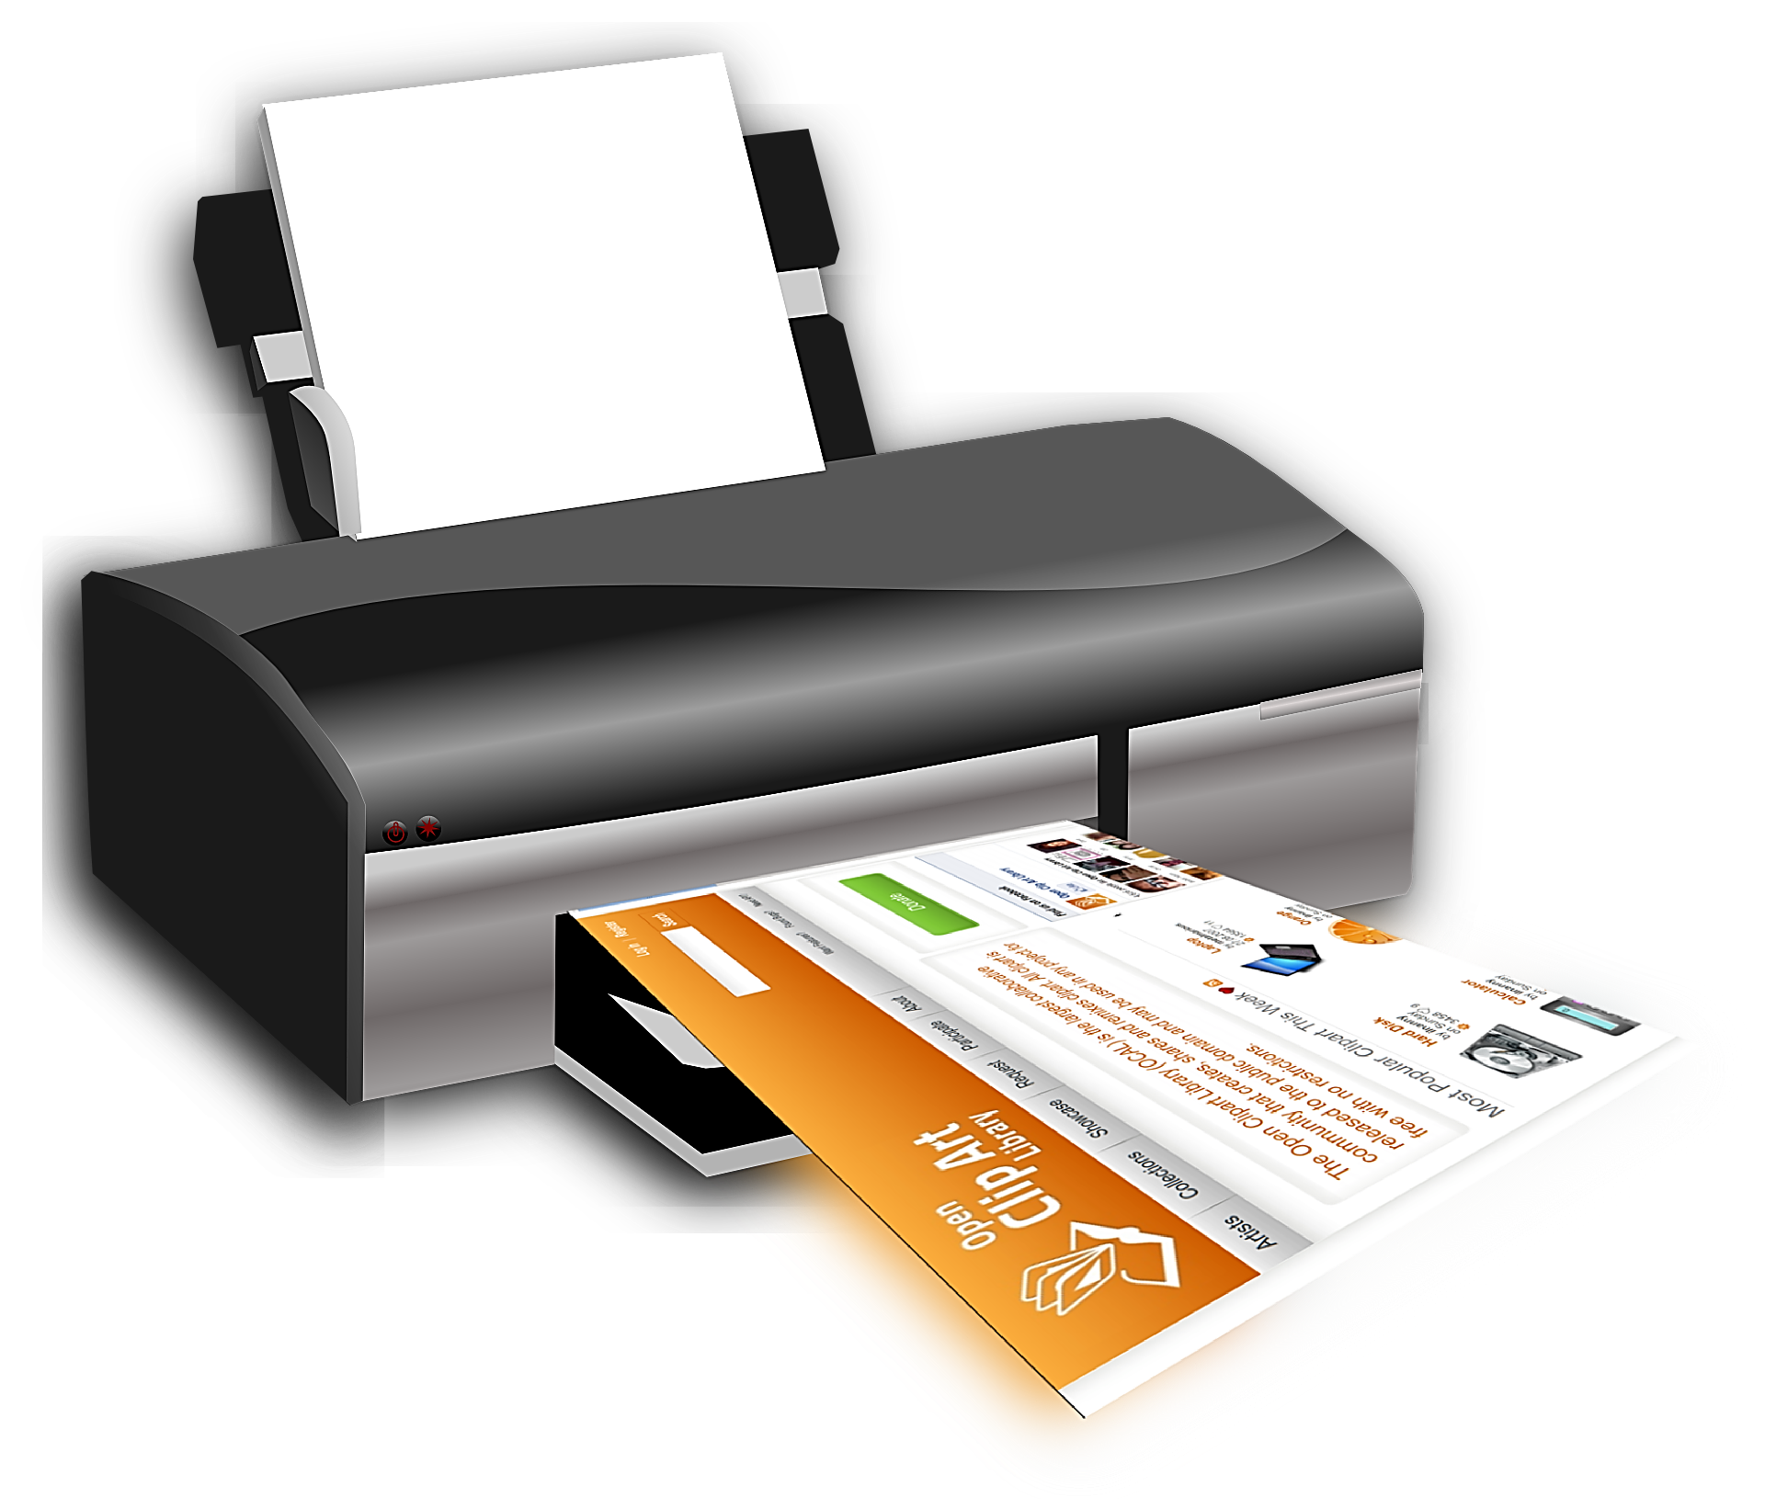
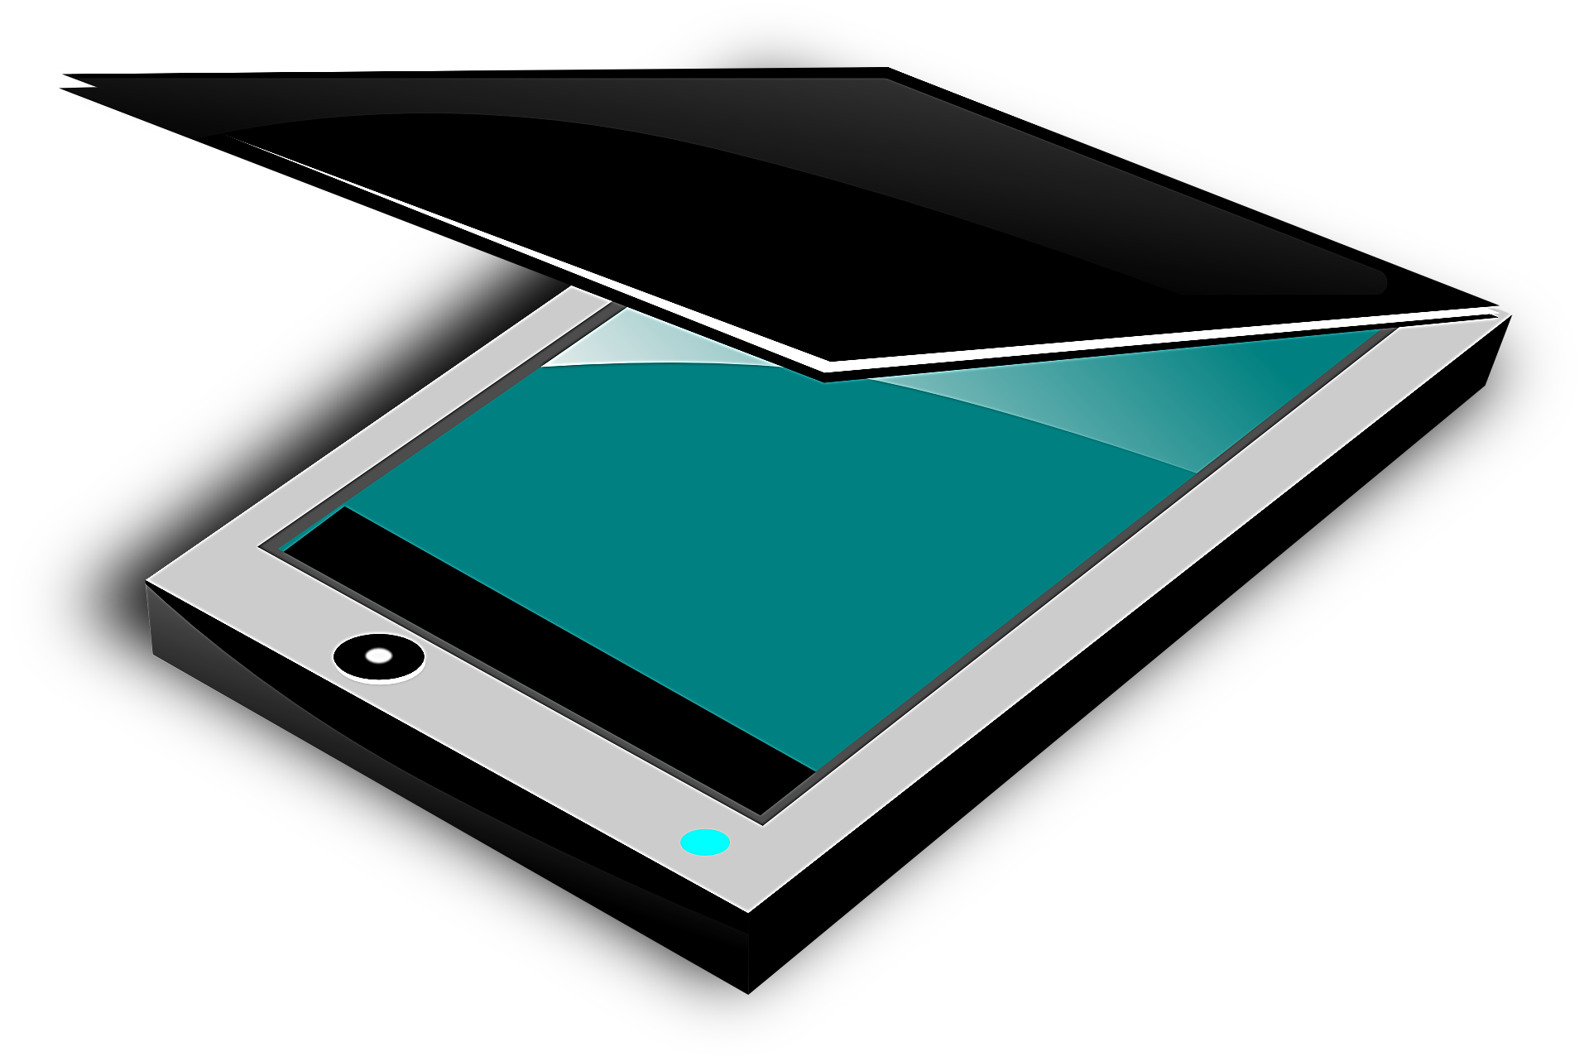
Determine Hardware Compatibility For Windows 10
The Microsoft Assessment And Planning Toolkit (MAP)
Microsoft Application Compatibility Toolkit (ACT)

Slide 18
Choose Between An Upgrade And A Clean Installation
Clean Install
Upgrade

Slide 19
Choose An Upgrade Path
Earlier Windows Version | Windows 10 Home | Windows 10 Pro | Windows 10 Enterprise
Windows 8/8.1 | ☑
Windows 8/8.1 Pro |  | ☑
Windows 8/8.1 Enterprise |  |  | ☑
Windows RT
Windows 7 Starter | ☑
Windows 7 Home Basic | ☑
Windows 7 Home Premium | ☑
Windows 7 Professional |  | ☑
Windows 7 Ultimate |  | ☑
Windows 7 Enterprise |  |  | ☑

Slide 20
Windows 7 Home
Windows 10 Home
Windows 10 Enterprise

Slide 21
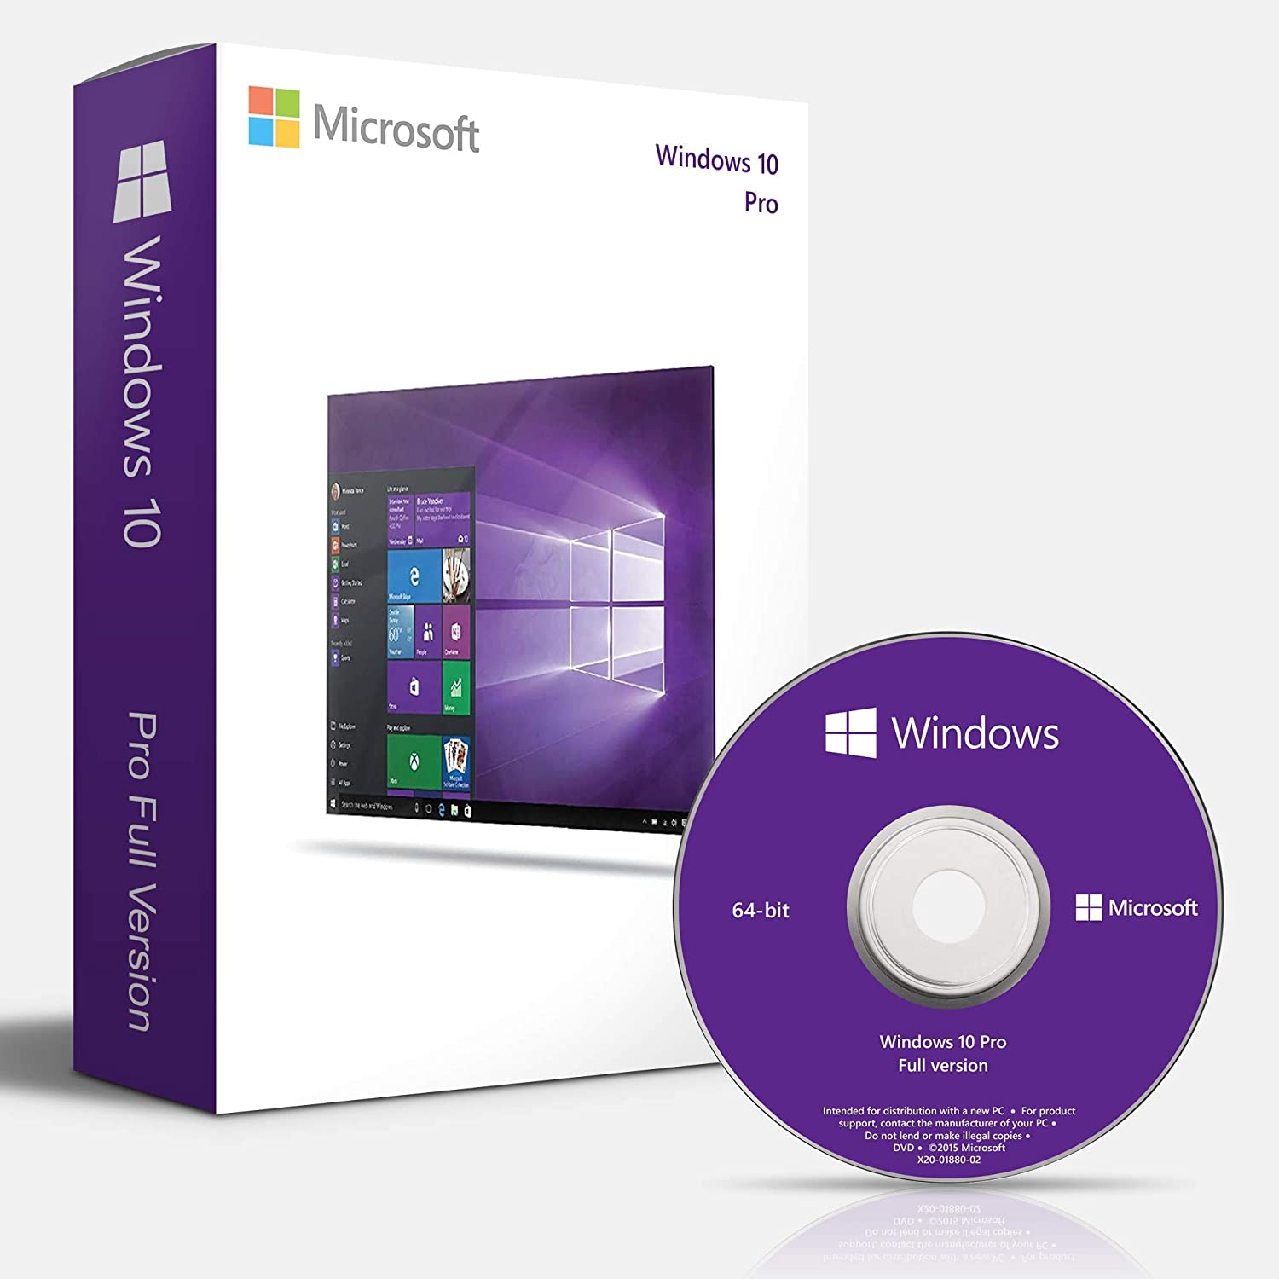
Determine Appropriate Editions By Device Type

Slide 22
Windows 10 Home:
Target Audience: General consumers (home users)
Key Features:
Cortana: Virtual assistant for personal use.
Windows Defender: Built-in security and antivirus.
Microsoft Edge: Web browser.
Windows Update: Automatic updates.
Basic Encryption: Device encryption.
Limited Remote Features: Basic support for remote desktop
No Advanced Networking: Lacks features like domain joining and group policies.

Slide 23
Windows 10 Pro:
Target Audience: Small businesses and professionals
Key Features:
BitLocker: Full-disk encryption to secure data on your device
Hyper-V: Virtualization technology to run virtual machines
Remote Desktop: Full remote desktop functionality
Group Policy: Allows admins to manage and configure devices remotely in a business network
Azure Active Directory: Cloud-based identity and access management
Windows Sandbox: Test apps and files in a secure environment.
Joining Domains: Ability to join a corporate network domain
Assigned Access: Restrict access to one app for a specific user, useful for kiosk mode

Slide 24
Windows 10 Enterprise
Target Audience: Small businesses and professionals
Key Features:
Virtualization Features: More advanced tools for virtualization management and protection
Long Term Servicing Channel : Provides businesses with a stable and predictable environment by allowing only security and critical updates, without adding new features.
Direct Access: Automatically connects users to the internal network without the need for a VPN.
Microsoft Desktop Optimization Pack : A suite of tools to improve management of desktops, such as virtualization and Group Policy control.
Windows To Go: Allows the operating system to be booted from external media like a USB drive.
Advanced Management & Deployment Tools: For enterprises to better manage large-scale deployments of Windows.

Slide 25

Choose the 32-bit or 64-bit versions
Memory
Security
Client Hyper-V
Performance

Slide 26

Select An Installation Strategy
High-touch Retail Media Deployment
Low-touch Deployment
WDS
Kit
Zero-touch Deployment

Slide 27



Determine And Create Appropriate Installation Media
DVD installation
USB installation
WDS deployment
Shared network folder installation

Slide 28
Important Considerations before install Windows
Firmware
Boot
UEFI
Boot / UEFI
HDD
MBR
4 partition
2 TB
GPT
128 partition
> 2T

Slide 29





Considerations before you chose Firmware type
UEFI and the GPT partitioning system for the hard drive work only with 64-bit versions of Windows
If the computer has a hard drive larger than 2 TB, you must use UEFI firmware, the GPT partition system, and a 64-bit version of Windows.
UEFI has a security system called Secure Boot, If you want to use this feature you must use UEFI, GPT, and a 64-bit edition of Windows.
To install Windows on an MBR hard drive, you must run UEFI in CSM mode. To install Windows on a
GPT drive, you must use UEFI and disable CSM mode.

Slide 30
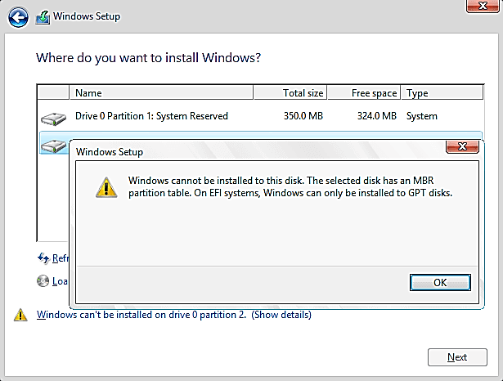

Slide 31
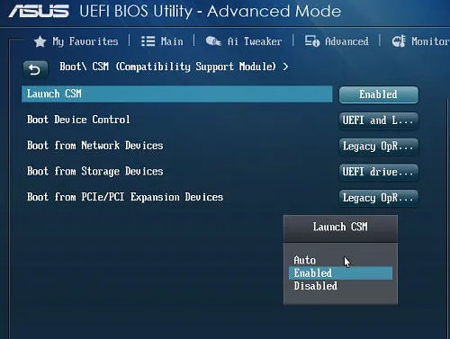
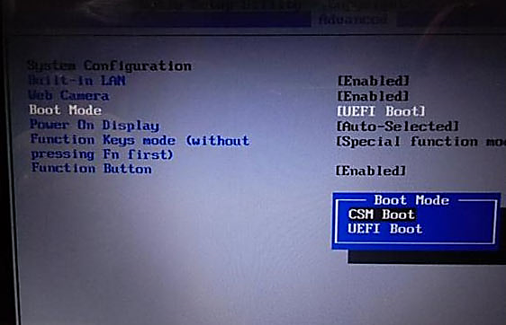
UEFI and Boot

Slide 32

Device Drivers

Slide 33

After Windows Installation

Slide 34
Install Device Drivers
Activate Windows
Install updates and service packs for Windows
Install applications
Set up user accounts and transfer or restore from backup user data and preferences to the new system

Slide 35



Install Device Drivers
Install identifier about name device
Install Driver Pack Here

Slide 36
Activate Windows
https://github.com/iamkunal9/windowsActivator/blob/main/activate.bat

Slide 37
Install updates and service packs for Windows

Slide 38
Install applications
https://www.farescd.com/

Slide 39
Set up user accounts and transfer or restore from backup user data and preferences to the new system

Slide 40
Windows Features

Slide 41
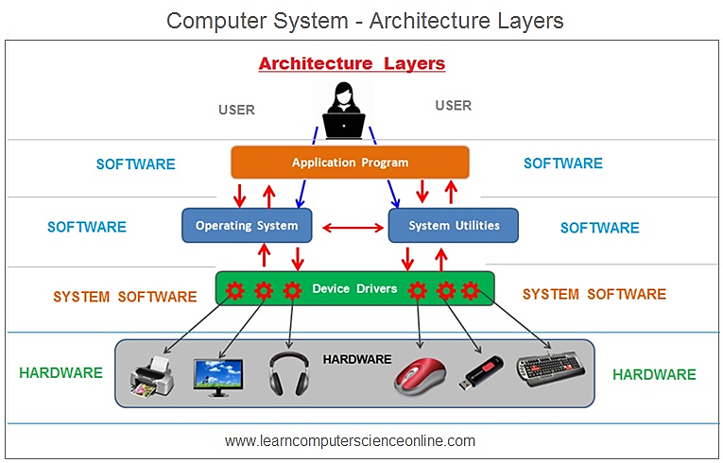

Slide 42
Operating System Functions
Resource Management
Process Management
File Management
Device Management
Security and Protection
User Interface Management
Network Management
Error Handling
Input/Output Management
Power Management
Software Compatibility
User Account Management

Slide 43

Managing Files & Directories
D:\Quran\EL-Agami\Fatha.mp3
Root Directory
Subdirectory to the Root
Subdirectory to the \Quran
File Name
File Extension

Slide 44

File Name. Extension

Slide 45
Text Files
Image Files
.txt | Plain Text File.
.doc / .docx | Microsoft Word Document.
.pdf | Portable Document Format.
.rtf | Rich Text Format.
.odt | OpenDocument Text (LibreOffice Writer).
.jpg / .jpeg | Compressed Image
.png | Image with Transparent Background
.gif | Static or Animated Image
.Bmp | Bitmap Image
.tiff | High-Quality Image
.svg | Scalable Vector Graphics
Video Files
Audio Files
.mp4 | Compressed Video
.avi | High-Quality Video
.mkv | High-Quality Video with Multiple Tracks
.mov | Apple QuickTime Video
.wmv | Windows Media Video
.mp3 | Compressed Audio
.Wav | High-Quality Audio
.Flac | Uncompressed Audio
.aac | Advanced Audio Codec
.ogg | Open-Source Audio File

Slide 46
Database Files
Compressed and Archive Files
. db | General Database File
.sql | SQL Query File
. mdb | Microsoft Access Database
. accdb | Modern Microsoft Access Database
.zip | ZIP Compressed File
.rar | RAR Compressed File
.tar | Unix Archive
.7z | 7-Zip Compressed File
.gz | GZIP Compressed File
Spreadsheet Files
Executable and Software Files
.xls / .xlsx | Microsoft Excel Spreadsheet
.csv | Comma Separated Values
.ods | OpenDocument Spreadsheet (LibreOffice Calc)
.exe | Windows Executable File
.bat | Batch File
.sh | Shell Script for Unix/Linux
.apk | Android Application File
.app | macOS Application
.msi | Windows Installer Package
Spreadsheet Files
.ppt / .pptx | Microsoft PowerPoint Presentation
.odp | OpenDocument Presentation (LibreOffice Impress

Slide 47

Tank you

